Slide 1

The Language of Attendance
The Importance of Role Allocation

Slide 2

Context
Grammar School
KS3-4 Boys, KS5 Boys & Girls
Recently increased pan to 150 per year group
12.9% Disadvantaged
3.3% SEN
One of the most deprived regions in the country
¾ White British in local area

Slide 3
Attendance
96% whole school attendance
93.9% disadvantaged attendance
88.7% SEN attendance
  1 student school refuser - change of named school instigated
  2 students with persistent exclusions

Slide 4
The Language of Attendance

Slide 5
Working Together
Good attendance starts with close and productive relationships with parents and pupils. Schools should treat all pupils and parents with dignity and staff should model respectful relationships to build a positive relationship between home and school that can be the foundation of good attendance. In working in partnership with parents, schools should discuss the link between attendance and attainment and wider wellbeing, and challenge parents’ views where they have misconceptions about what ‘good’ attendance looks like.

Slide 6
Language
Parents often do not understand the language we use around attendance
Some demographics can be less likely to engage - often those we want to prioritise!
Encouraging good attendance is an act of persuasion

Slide 7
The Project
Education Endowment Fund
Behavioural Insights Team
Focus on how the language used to communicate to parents might improve attendance
Report published summer 2025

Slide 8
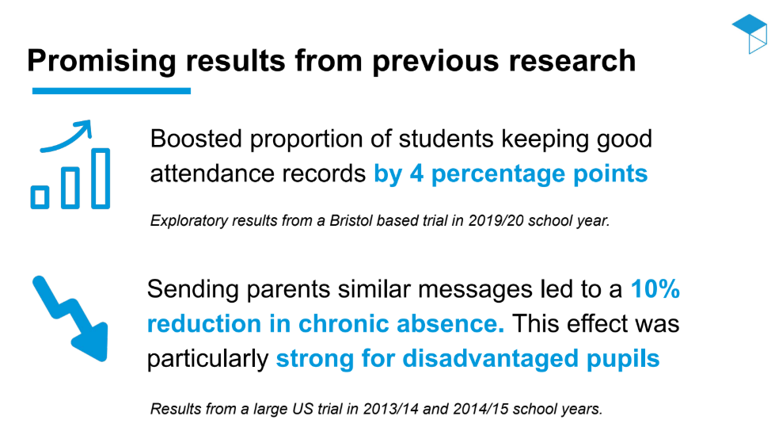
Previous Research

Slide 9
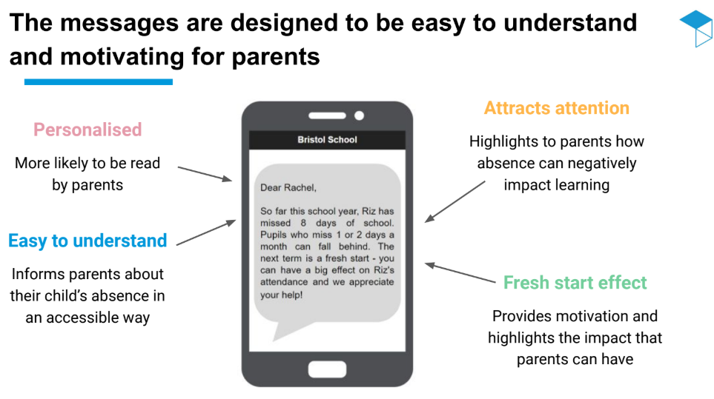
The Messages

Slide 10

What We Do Now
Dear Parent/ Carer. Last half term, [Inset Forename] missed 0 days of school. Students that consistently attend school are more likely to get better grades in their exams, and have better understanding of content. Thank you for your continued support of his attendance, and we are looking forward to another positive half term.
Dear Parent/ Carer. Last half term, [Inset Forename] missed 1 day of school. We appreciate that this is far from a large number, but pupils who miss 1 or 2 days a month can fall behind. We also appreciate that there are reasons for his absence, however we have a legal obligation to keep you informed of your son's attendance. This half term is a fresh start, and we really appreciate your help in ensuring his attendance stays positive.

Slide 11
What We Do Now
Dear Parent/ Carer. Last half term, [Inset Forename] missed 2.5 days of school. We appreciate that this is far from a large number, but pupils who miss 1 or 2 days a month can fall behind and therefore fall into our early intervention category. We also appreciate that there are reasons for his absences, however we have a legal obligation to keep you informed of your son's attendance. This half term is a fresh start, and we really appreciate your help in ensuring his attendance stays positive.
Dear Parent/ Carer. Last half term, [Inset Forename] missed 5 days of school. This currently puts him in the category of a persistent absentee, and pupils in this category are significantly more likely to fall behind and require additional intervention. Whilst we appreciate that there are reasons for this, we have a legal obligation to keep you informed of your son's attendance. This half term is a fresh start, and we really appreciate your help in ensuring his attendance stays positive.

Slide 12
The Importance of Role Allocation

Slide 13
Working Together
All schools have a continuing responsibility to proactively manage and improve attendance across their school community. As set out in chapter 1, attendance is the essential foundation to positive outcomes for all pupils including their safeguarding and welfare and should therefore be seen as everyone’s responsibility in school. That starts with the senior attendance champion on the school’s leadership team, but includes all school staff.

Slide 14
Our School
Legal Duty to Promote Attendance
Percentage | School Action | Promotion
95-100% | Prevention | Monitoring by Form Tutor Displays regarding attendance are updated regularly Attendance messages half-termly Attendance data is shared weekly during form time Rewards are given on a termly basis for those with good or improved attendance Termly newsletter update Late procedures Breakfast club

Slide 15
Our School
Legal Duty to Promote Attendance
Percentage | School Action | Promotion
90-95% | Early Intervention | As above, alongside: Monitoring by Head of Year Parental meetings with Heads of Year Penalty notices Attendance letters Attendance support plan In-school support such as peer-mentoring, School Welfare Officer or pastoral interventions.

Slide 16
Our School
Legal Duty to Promote Attendance
Percentage | School Action | Promotion
Less than 90% | Targeted | As above, alongside: Monitoring by AHT Pastoral Parental meetings with AHT Pastoral Attendance support plan Home visits Alternative working arrangements (e.g. library) Reduced timetable/Off-site provision In-school support such as peer-mentoring, School Welfare Officer or pastoral interventions. External agencies (such as Educational Welfare Officer, Inclusion and Attendance Service, Early Help, Children's Social Care)

Slide 17
Responsibilities
Role | Responsibility | Including
Trustees | Whole school | Set high expectations of all school leaders, staff, pupils and parents. Monitoring of processes and attendance figures for the whole school.
Headteacher | Whole school | Set high expectations of all school leaders, staff, pupils and parents. Monitoring of processes and attendance figures for the whole school. Fixed penalty notices
Assistant Headteacher (Pastoral) | Targeted Students | Data and reporting Accountability Liaising with Attendance Officer Liaising with internal and external agencies Home visits Parent meetings Overseeing reduced timetables
Attendance Officer | All Students | Data and reporting Daily attendance calls Attendance coding Weekly/termly attendance reports and analysis Parent letters Home visits Reporting of reduced timetables to LA/EHE Liaising with internal and external agencies including Education Welfare Officers Fixed penalty notices

Slide 18
Responsibilities
Role | Responsibility | Including
Head of Year | Early Intervention | Analysis of termly/weekly attendance data Liaising with Attendance Officer Liaising with internal agencies Organisation of reduced timetables Parent meetings
Tutor | Prevention | Registering students in a timely manner Delivering key attendance messages Tracking tutee attendance weekly Attendance conversations Parent phone calls
Teacher | Prevention | Registering students in a timely manner Tracking student attendance to lessons Providing work for absent students where appropriate Parent phone calls
Support Staff | Role dependent | Registering students in a timely manner Parent phone calls Providing support for students

Slide 19
How This Helps
Everyone knows what their responsibilities are
Allows for staff accountability
Avoids overlap of communication/intervention

